Slide 1

Unit-1 Introduction to Dart Programming Language
Mobile Application Development using Flutter (MADF)
DU # 2104CS501
Dr. Sharon V Mohtra
Department of Computer Applications
sharon.mohtra@darshan.ac.in

Slide 2

Outline
Overview & features
Dart tools & setup
Dart program structure
Variable & data types
Access modifiers
Typecasting
Operators
Nullable & non-nullable variables
Decision making & loops
Collection classes
Functions
Class, constructor & object
Looping

Slide 3
Dart Programming Language
Introduction

Slide 4
History
Dart is a programming language developed by Google, initially released in 2011.
It gained popularity as the primary language for building web and mobile applications with the release of Flutter, Google's UI toolkit.
The latest stable release of Dart is Dart 3.3, enhance development productivity and performance in Flutter and other Dart projects.
Dart documentation is available online as https://dart.dev/guides.
Dart
versions
1.0
(2013)
2.0
(2018)
3.0
(2023)
Stable SDK for
web apps
Type inference
& browser APIs
More features
like null safety

Slide 5






Overview & features
Dart is an open-source general-purpose programming language.
It supports application development in both client and server-side contexts.
It is particularly popular for the development of Android apps, iOS apps, IoT (Internet of Things) devices, and web applications using the Flutter Framework.
The syntax has a strong similarity to Java, C, and JavaScript.
Also it is a dynamic object-oriented language.
Live applications that have been developed using Dart as the programming language are Google Ads, Google Analytics, The New York Times app, Google Fuchsia OS, ebay Motors app, Hamilton Musical app, BMW app, DartPad, etc.
v
Note: All Photos by Unknown Author are licensed under CC BY-NC-ND, Gif courtesy: https://flutter.dev/showcase

Slide 6
Advantages & Disadvantages
Advantages:
Flutter has fast development time due to flutter architecture’s hot reload.
Flutter’s widgets are highly customizable and you can also create custom widgets.
It allows for cross-platform development so it cuts down on development time, and no need to maintain separate codebases for different platforms.
It has a large and active community of developers and their contribution.
Disadvantages:
It still has limited library support.
Flutter apps may be larger in size.
It’s a relatively new framework.

Slide 7



Dart Tools
The following are some essential Dart programming tools you can use for developing applications:
IDEs and Editors
Android Studio: A popular IDE that supports Dart development.
IntelliJ IDEA: Another powerful IDE integrates well with Dart.
Visual Studio Code (VS Code): A lightweight code editor with Dart support.
DartPad
Dart CLI
A no-download-required online tool that allows you to learn Dart syntax and experiment with language features. It supports Dart’s core libraries and is great for quick code snippets and learning.
The general-purpose command-line interface (CLI) included in the Dart SDK. It allows you to create, format, analyze, test, document, compile, and run Dart code and works seamlessly with the pub package manager.

Slide 8
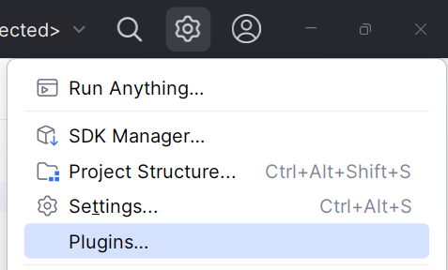
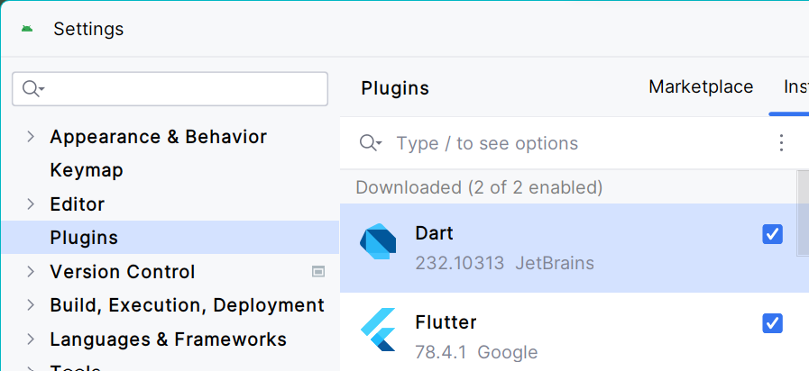
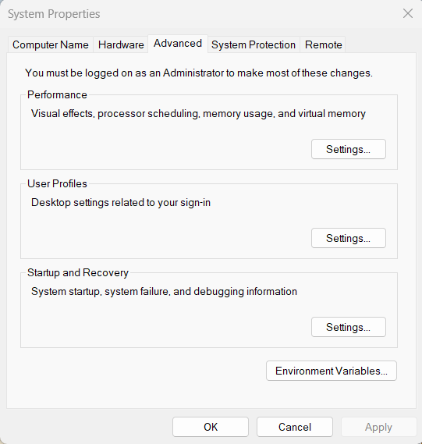
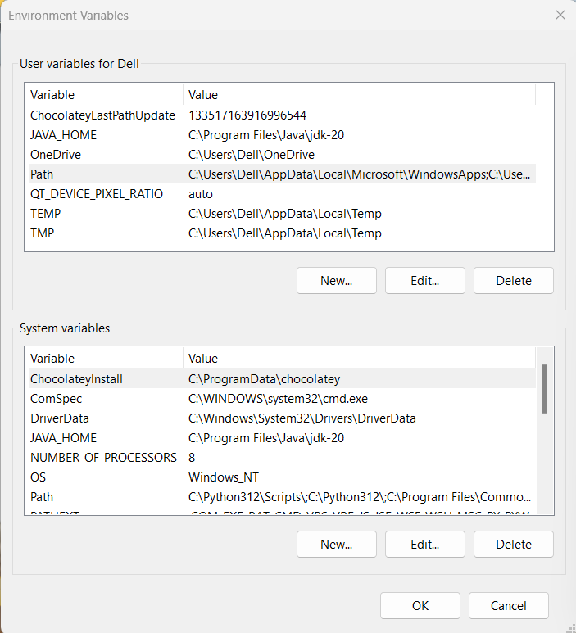
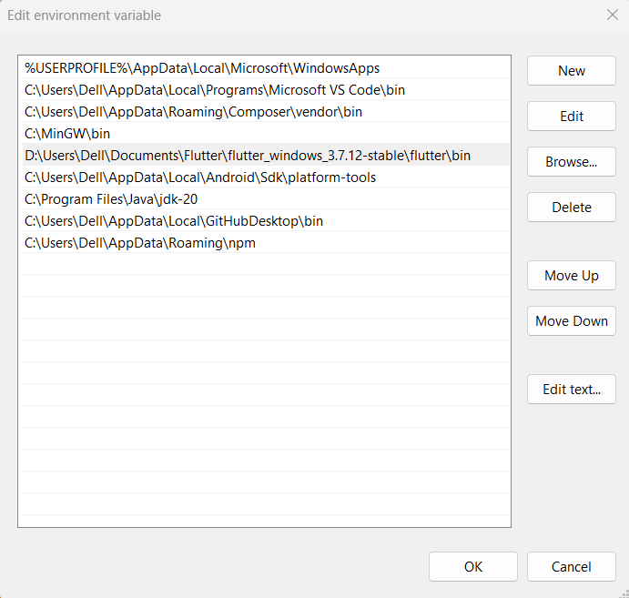
Installation
Check system requirements and install Android Studio
from https://developer.android.com/studio/install.
To set up Dart and Flutter in Android Studio:
Open Android Studio -> on the title bar select Settings -> Plugins.
In the Plugins -> search for both plugins -> select the Flutter
plugin and click Install. Then install Dart plugin.
Download flutter SDK from https://docs.flutter.dev/get-started/install and install to a particular path. Set path in environment variables to the Flutter SDK’s bin directory (e.g., C:\flutter\bin).
Go to system properties -> environment variables -> path -> Edit -> paste the copied path of flutter SDK.

Slide 9
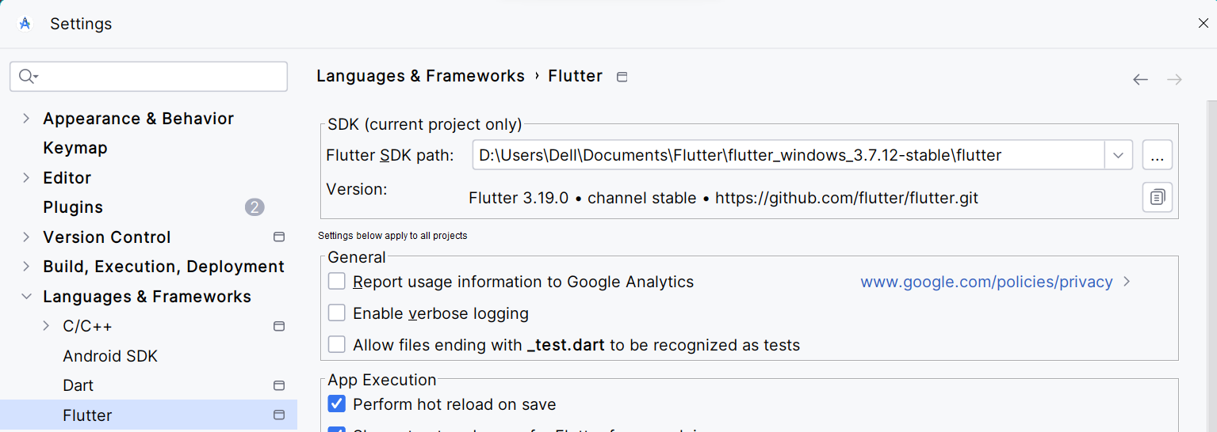
Setup
Now in Android Studio -> set path in Settings -> under Languages & Frameworks -> select Flutter -> browse and set Flutter SDK path from the installed Flutter SDK location.
The dart SDK is already included in the flutter SDK.
It can also be downloaded separately from https://dart.dev/get-dart.
It includes the the libraries and command-line tools to develop Dart command-line, server, and web apps.
It contains the Dart VM compiler - Just-in-Time (JIT) compiler (it translates Dart code into machine code while the program is running) and Ahead-of-Time (AOT) compiler (for producing machine code ahead of time).
It includes the dart2js (Dart-to-JavaScript compiler). It is also called a transpiler that translates dart source code into another platform (android/iOS) code.

Slide 10
Syntax
Every programming language has its own syntax.
Syntax defines the rules to write effective programs.
A dart program structure includes the following key elements:
Keywords: essential words that convey specific meanings to the compiler.
Identifiers: names given to variables that the compiler can read
Variables: represent data temporarily held by a word or character like name, age, etc. They can change their values.
Data types: dart supports various built-in types, including String, int, double, etc.
Symbols: Punctuation marks like semicolons ; to end lines.
Comments: Used for code documentation and readability. Single-line comments start with // and multi-line comments use /* ... */.
The dart source files are saved with .dart extensions.

Slide 11
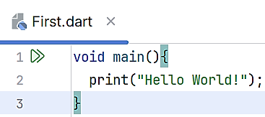
Dart Program Structure
Every programming language has its own syntax.
A dart program structure includes the following key elements
Keywords Essential words that convey specific meanings to the compiler. Common keywords are as follows.
Identifiers
Names given to variables that the compiler can read. Rules for identifiers are as follows.
Variables Represent data temporarily held by a word or character like name, age, etc. & change their values.
Data types Dart supports various built-in types, including String, int, double, etc.
Symbols Punctuation marks like semicolons ; to end lines.
Comments Used for code documentation and readability. Single-line comments are // & multi-line comments use /* ... */.
Syntax defines the rules to write effective programs.
import, else, as, abstract, switch, super, in, enum, assert, export, const, var, void, static, do, async, await, catch, on, null, new, class, break, continue, false, true, get, hide, set, show, dynamic, return, and rethrow.
No special symbols except _ (for private scope or unused variable) and $ (for combining strings).
Cannot be reserved keywords.
No spaces allowed in the variable name.
Case-sensitive.
Other major elements include Operators and Expression, Decision Making and Loop, Functions, Classes, Libraries and Packages, Typedefs, Data Structures like Collections and Generics

Slide 12
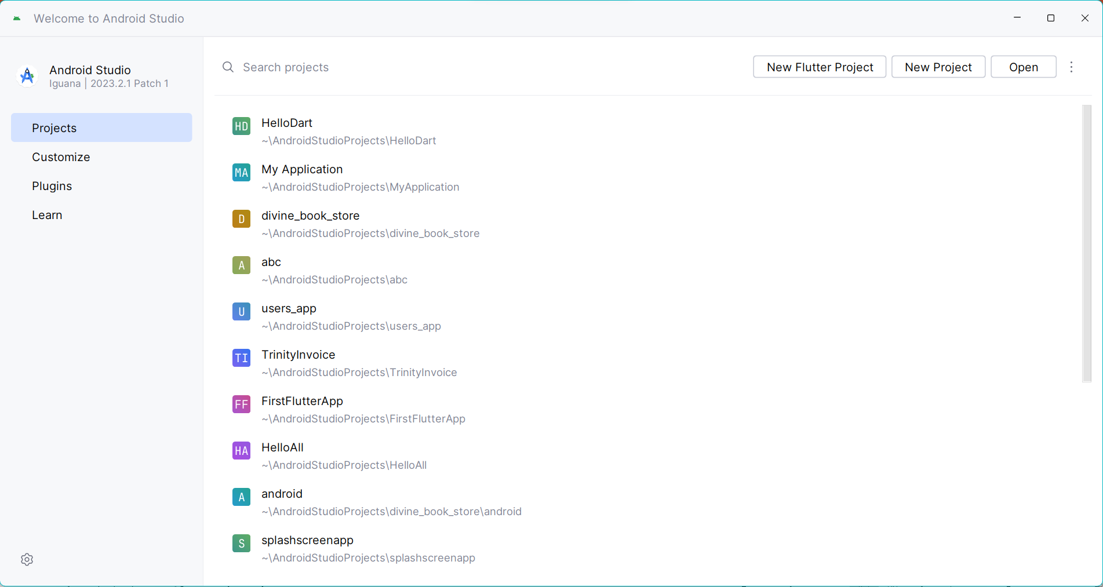
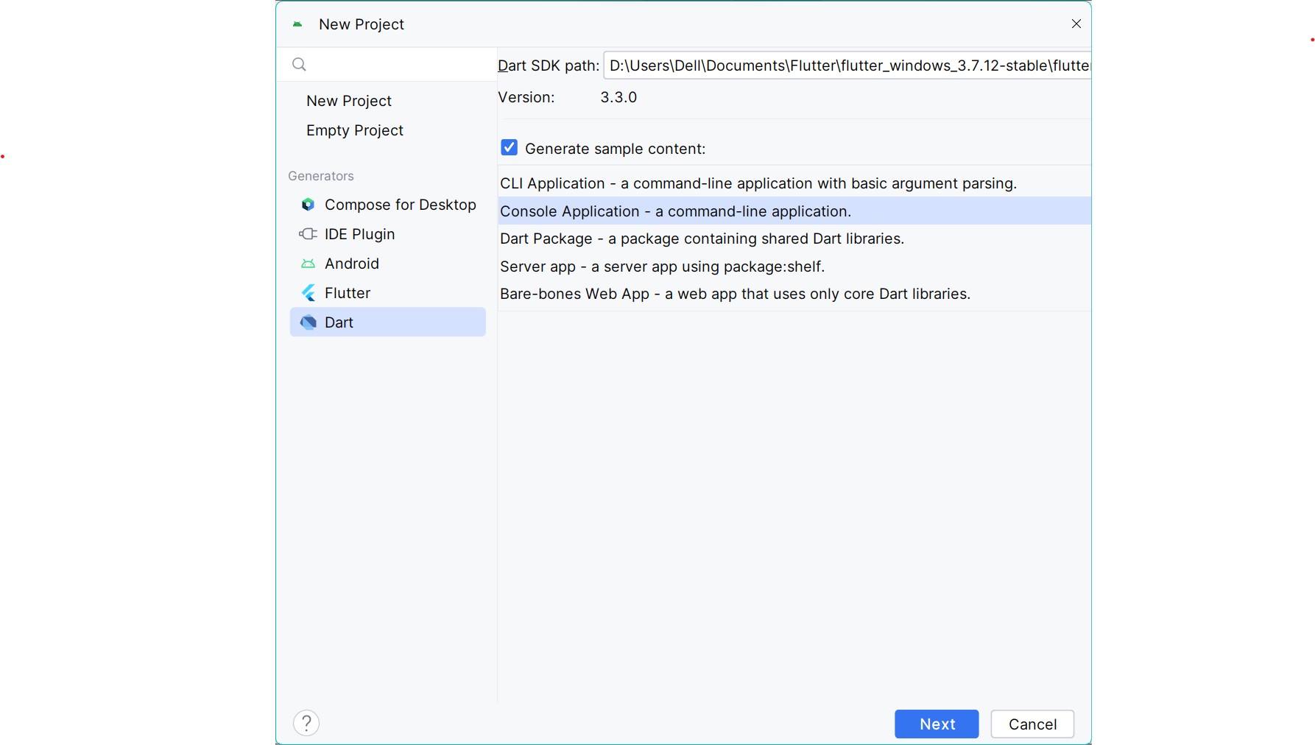
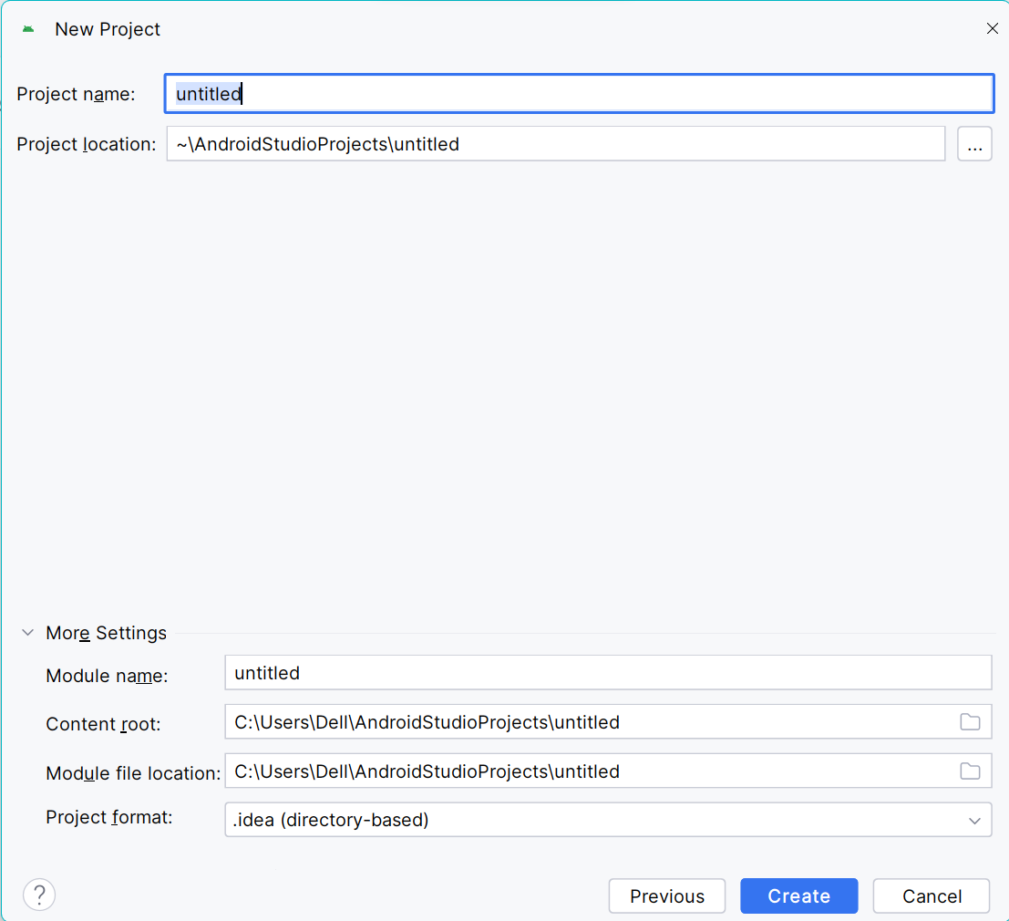
Dart in Android Studio
Open Android Studio. The version used here is Android-Studio-Jellyfish 2023..1.
In the Welcome window -> select Projects ->click on New Flutter Project.
In New Project -> select Dart -> Console Application -> Click on Next.

Slide 13
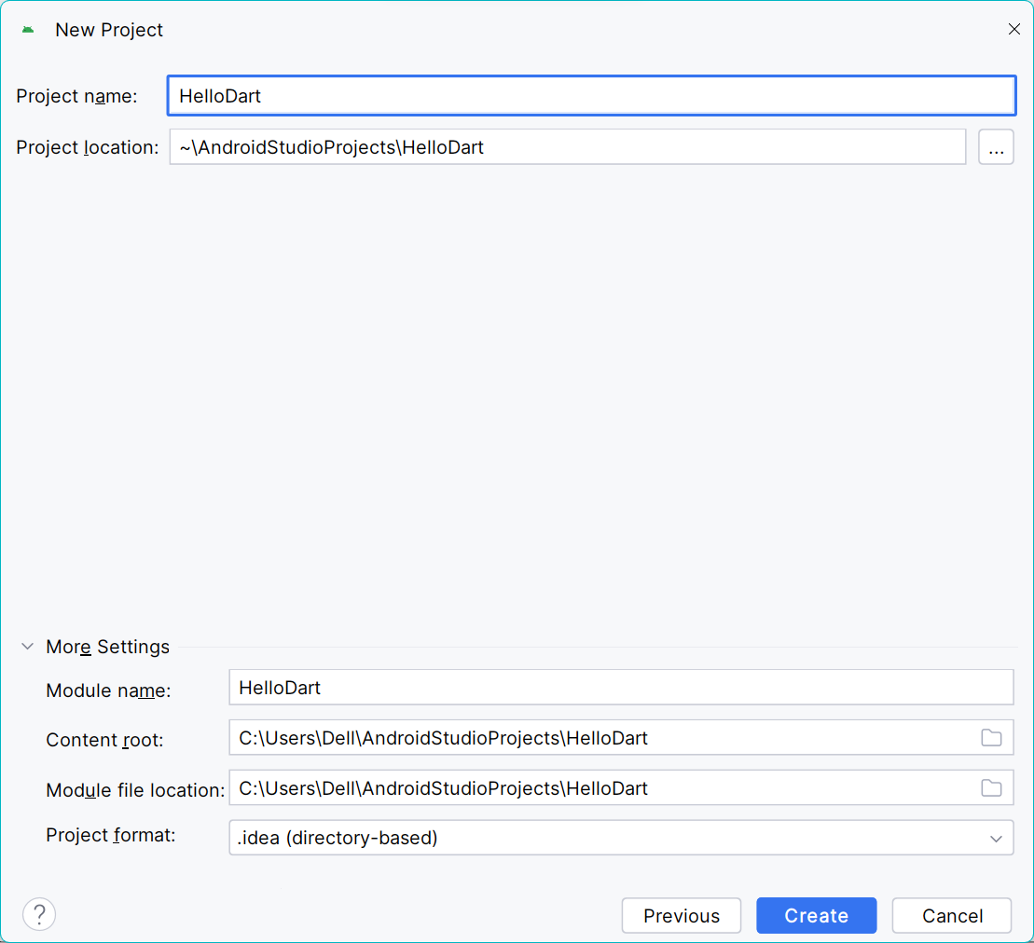
Create dart project
In New Project -> enter project name -> Click on Create.

Slide 14
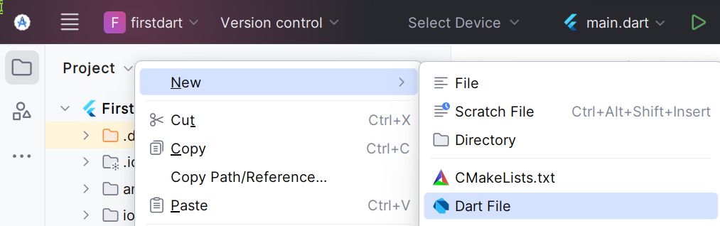
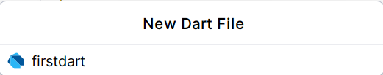
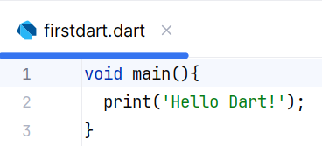
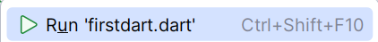
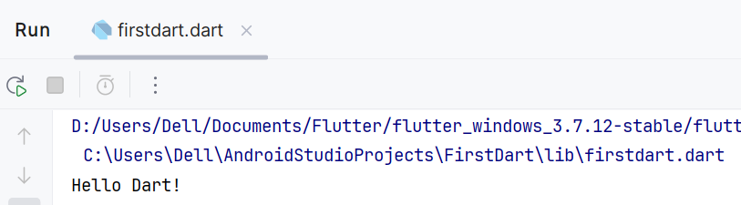
First Dart program
In the firstdart project right click on libraries folder -> New -> Dart File.
And provide dart filename like “firstdart” in the filename box.
Write the code in the firstdart file as shown.
Right click on the editor or filename and
click run from the menu.
Output will be shown in Run window
on console.
1
2
3

Slide 15
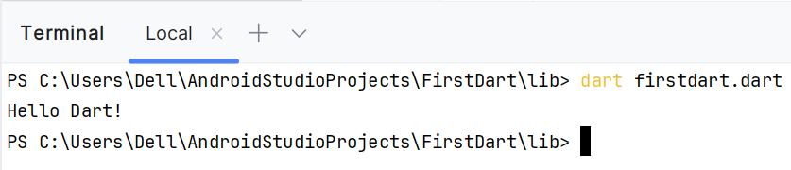
main() function
The main() function is a predefined method in Dart.
This method acts as the entry point to the application for execution.
print() is a predefined function that prints the specified string or value
to the standard output i.e. the terminal.
A Dart program can also be executed in the command prompt or in Terminal window (Android Studio) using the following command.
dart file_name.dart => Output: Hello Dart!
Print Hello Dart.
void main() {
print("Hello Dart!");
}

Slide 16


Variables and Data types
A variable in dart is like a named container/location in memory to store data (such as numbers, text, or other values) and get it later by using the variable's name.
The type of data a variable can hold depends on how you declare it.
Dart is a statically typed language, meaning each variable must have a specific data type assigned to it.
These data types allow developers to work with different kinds of data efficiently.
Like any other programming language, in dart, data types define the kind of data that a variable, constant, or function can hold.
Memory
1
Data type
Variable
Data
Named location

Slide 17
Var & Val
Built-in Data Type | Keyword | Description | Dart examples
Numbers | int | Represents whole numbers (64-bit max). | int age = 25;
 | double | Represents 64-bit floating-point numbers. | double pi = 3.14
 | num | An inherited data type of int and double. It can hold both integer and floating-point values. | num result = 10 + 3.5;
Strings | String | Used to represent a sequence of characters embedded in either single or double quotes. | String str = 'A single-quoted string’; String str2 = "A double-quoted string";
Boolean | Bool | Represents Boolean values (true or false). | bool isActive = true;
Lists | [ ], List | Similar to arrays in other languages. Used to represent a collection of objects. | var numbers = [1, 2, 3, 4, 5]; List<int> fixedList = List.filled(5, 0, growable: false);
Maps | Map | Represents a set of key-value pairs. . | Map<String, int> ages = Map(); ages[‘Rejoice'] = 14;
Dynamic | dynamic | A dynamic variable can initialized with any type, later can be assigned to different expressions. | dynamic vari = “Dart For Flutter"; vari = 3.14; //reassign

Slide 18
Number
Numbers in Dart are used to represent numeric literals.
The Number Dart come in two types.
Integer
Double
Integer:
Integer values represent non-fractional values.
For example, the value "10" is an integer.
Integer literals are represented using the int keyword.
Double :
The Double data type in Dart represents a 64-bit (double-precision) floating-point number.
For example, the value "10.10".
The keyword double is used to represent floating point literals.
Object
num
Syntax
1
int A = 20;
int
double
Syntax
1
double B = 30.0;

Slide 19
Number
Program
Output
1
2
3
4
5
6
7
8
9
10
11
12
13
14
15
16
17
18
19
20
void main(){
// declare an integer
int num1 = 2;
// declare a double value
double num2 = 1.5;
// print the values
print(num1);
print(num2);
var a1 = num.parse("1");
var b1 = num.parse("2.34");
var c1 = a1+b1;
print("Product = ${c1}");
}
1
2
3
2
1.5
Product = 3.34

Slide 20
Strings
Strings represent a sequence of characters.
String datatype used to store some data like name, address etc.
A Dart String is a sequence of UTF-16 code units.
The keyword String is used to represent string literals.
String values are embedded in either single or double quotes.
You can use the plus (+) operator to concatenate strings:
Syntax
1
String string = ‘Darshan University’;
Syntax
1
String string = ‘Darshan’ + ‘University’;

Slide 21
Strings
You can use ${} to interpolate the value of Dart expressions within strings. The curly braces can be omitted when evaluating identifiers.
Syntax
1
2
3
String str = ‘is at hadala’;
print(‘Darshan University $str’);
print(‘Darshan University ${str.toString()}’);
Program
Output
1
2
3
4
5
6
void main(){
String str = ‘Darshan University’;
String str1 = ‘ is at hadala’;
print(str);
print(str + str1);
}
1
2
Darshan University
Darshan University is at hadala

Slide 22
Boolean
The Boolean data type represents Boolean values true and false.
Dart uses the bool keyword to represent a Boolean value.
These data types have two values that are True and False.
Syntax
1
bool isIttrue1 = true;
Program
Output
1
2
3
4
5
6
void main(){
String str = 'Darshan University';
String str1 = 'is at hadala';
bool val = (str==str1);
print(‘$val’);
}
1
false

Slide 23
Access Modifiers
In Dart we don’t have keywords like public, protected, and private to control the access scope for a property or method.
It use _ (underscore) at the start of the variablename to make a data member private.
In Dart, the privacy is at library level rather than class level.
It means other classes and functions in the same library still have the access.
So, a data member is either public (if not preceded by _) or private (if preceded by _).

Slide 24
Access Modifiers : Example
For example, there is a library a.dart with a class named A. The class has two fields: first (public) and _second (private).
Example
Output
1
2
3
4
5
6
7
8
9
10
11
12
13
class A
{
String? first;
String? _second;
}
void main()
{
A a = new A();
a.first = 'New first';
a._second = 'New second';
print('${a.first}: ${a._second}');
}
1
New first: New second

Slide 25
Typecasting
Typecasting is to convert the data type of one variable into another.
Dart's type system includes static type checking, which helps to catch and fix errors during compile-time, reducing the chances of runtime errors.
There are two ways of typecasting:
Explicit Cast: In Dart it is a way to convert an object of one type to another. Dart provides the 'as' keyword for this purpose. However, using 'as' for incompatible types can lead to a type error.
Implicit Cast: Dart's type system automatically converts one type to another if it's safe. For instance, an integer can be implicitly cast to a double.
Explicit
Implicit
1
2
3
4
5
void main() {
var object = '123';
var string = object as String;
print(string);
}
1
2
3
4
5
void main() {
int integer = 10;
double doubleValue = integer.toDouble();
print(doubleValue);
}
Output
Output
1
123
1
10.0

Slide 26
const
const for variables is used to make compile-time constants.
If the const variable is at the class level, mark it static const.
Any variable can have a constant value.
Example
1
2
3
4
5
const a = 100;
const double area = 1.5 * b
//any variable
var b = const [];
b = [1, 2, 3];

Slide 27
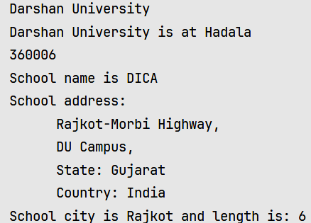
Write a dart program to print college name and address.
Declaring, initializing and accessing
integer and string variables
1
2
3
4
5
6
7
8
9
10
11
12
13
14
15
16
17
void main() {
int zipcode = 360006;
String schoolName = "DICA";
String address = """
DU Campus,
State: Gujarat
Country: India""";
String city = "Rajkot";
String str = 'Darshan University';
String str1 = ' is at Hadala';
print(str);
print(str + str1); //+ sign concatenates String
print(zipcode);
String road = 'Rajkot-Morbi Highway';
print("School name is $schoolName");
18
19
20
print("School address: \n \t $road,\n$address");
print("School city is $city and length is: ${city.length}"); //${} includes the value of Dart expressions within strings
}
Output
1
2
3
4
5
6
7
8
9
10

Slide 28
Write a dart program to perform addition on numbers.
Declaring, initializing and accessing
single integer, double variables
1
2
3
4
5
6
7
8
9
10
11
12
13
14
15
void main() {
int num1 = 10;
double num2 = 20.2;
num num3 = 30;
num num4 = 40.4;
num sum = num1 + num2 + num3 + num4;
// Display output
print("Num 1 = $num1");
print("Num 2 = $num2");
print("Num 3 = $num3");
print("Num 4 = $num4");
print("Sum is $sum");
print("Sum is ${sum.toStringAsFixed(2)}");
}
Output
1
2
3
4
5
6
7
Num 1 is 10
Num 2 is 20.2
Num 3 is 30
Num 4 is 40.4
Sum is 100.6
Sum is 100.60

Slide 29
Read values
To make the program dynamic, it is necessary to take value from the user.
In dart we use import 'dart:io' package for input/output operations.
The standard input from the user through console is taken by readLineSync() function.
This method always read values in string format only. If we want to read int or double value, we need to parse it using parse() method.
Declaring, initializing and accessing integer, double and string variables
Output
1
2
3
4
5
6
7
8
9
void main(){
print('Enter BookName, Pages, Price');
String? bookName = stdin.readLineSync();
int? page = int.parse(stdin.readLineSync()!);
double? price = double.parse(stdin.readLineSync()!);
print('BookName : $bookName’);
print('Pages : $page & Price : $price ');
}
1
2
3
4
5
6
7
8
Enter BookName, Pages, Price
C prog
50
100
BookName:C prog
Pages : 50 & Price : 100.0

Slide 30
Operators
In Dart, operators are special symbols used to perform operations on variables and values.
They help in working with data and making decisions based on conditions.
Dart supports the operators shown in the following table with its associativity and operator precedence from highest to lowest.
Description | Operator | Associativity
Description | Operator | Associativity
unary postfix | expr++ expr-- () [] ?[] . ?. ! | None
equality | == != | None
unary prefix | -expr !expr ~expr ++expr --expr await expr | None
logical AND | && | Left
logical OR | || | Left
multiplicative | * / % ~/ | Left
if-null | ?? | Left
additive | + - | Left
conditional | expr1? expr2 : expr3 | Right
shift | << >> >>> | Left
bitwise AND | & | Left
cascade | .. ?.. | Left
bitwise XOR | ^ | Left
assignment | = *= /= += -= &= ^= etc. | Right
bitwise OR | | | Left
relational and type test | >= > <= < as is is! | None

Slide 31
Built-in operators
O
Arithmetic
P
Relational
E
Assignment
R
Logical
A
Bitwise
T
Conditional
O
Increment/
Decrement
R
Type Test

Slide 32
Built-in operators
These are the following built-in operators in Dart:
Arithmetic Operators
Relational Operators
Assignment Operators
Logical Operators
Bitwise Operators
Conditional/Ternary Operator
Increment/Decrement Operator
Type Test Operators

Slide 33
Arithmetic Operators
Operators which are used to perform arithmetic operation on the operands.
Operator | Name | Description
+ | Addition | Use to add two operands.
- | Subtraction | Use to subtract two operands.
-expr | Unary Minus | Use to reverse the sign of the expression.
* | Multiply | Use to multiply two operands.
/ | Division | Use to divide two operands.
~/ | Division (Integer Division) | Use to divide two operands but give output in integer.
% | Modulus | Use to give remainder of two operands.

Slide 34
WAP to implement arithmetic operators.
Arithmetic Operators
1
2
3
4
5
6
7
8
9
10
11
12
13
14
void main(){
int a = 7, b = 3;
var c = a + b;
print("Sum of a and b is $c");
var d = a - b;
print("The difference between a and b is $d");
var e = -d;
print("The negation between a and b is $e");
var f = a * b;
print("The product of a and b is $f");
var g = b / a;
print("The quotient of a and b is $g");
15
16
17
18
19
20
var h = b ~/ a;
print("The quotient of a and b is $h");
var i = b % a;
print("The remainder of a and b is $i");
}
Output
1
2
3
4
5
6
7
8
9
Sum of a and b is 10
The difference between a and b is 4
The negation between a and b is -4
The product of a and b is 21
The quotient of a and b is 0.42857142857142855
The quotient of a and b is 0
The remainder of a and b is 3

Slide 35
Relational Operators
Operators which are used to perform relational operation on the operands and give result as true or false.
Operator | Name | Description
> | Greater than | Used to check which operand is bigger
< | Less than | Used to check which operand is smaller.
>= | Greater than or equal to | Used to check which operand is bigger or equal.
<= | less than equal to | Used to check which operand is smaller or equal.
== | Equal to | Used to check operands are equal to each other.
!= | Not Equal to | Used to check operand are not equal to each other.

Slide 36
WAP to implement relational operators.
Relational Operators
1
2
3
4
5
6
7
8
9
10
11
12
13
14
15
16
17
var g = b == a;
print("a and b are equal is $g");
var h = b != a;
print("a and b are not equal is $h");
}
void main(){
int a = 7, b = 3;
var c = a > b;
print("a is greater than b is $c");
var d = a < b;
print("a is smaller than b is $d");
var e = a >= b;
print("a is greater than or equal to b is $e");
var f = a <= b;
print("a is smaller than or equal to b is $f");
Output
1
2
3
4
5
6
7
a is greater than b is true
a is smaller than b is false
a is greater than or equal to b is true
a is smaller than or equal to b is false
a and b are equal is false
a and b are not equal is true

Slide 37
Assignment Operators
Operators which are used to assign some values to variables.
Operator | Name | Description
= | Equal to | Use to assign values to the expression or variable
+= | Addition & Equal to | It adds the right operand to the left operand and assigns the result to the left operand.
-= | Subtraction & Equal to | It subtracts the right operand from the left operand and assigns the result to the left operand.
*= | Multiplication & Equal to | It multiplies the right operand with the left operand and assigns the result to the left operand.
/= | division & Equal to | It divides the left operand with the right operand and assigns the result to the left operand.
??= | Null-aware Assignment | Assign the value only if it is null.

Slide 38
WAP to implement assignment operators.
Assignment Operators
15
16
17
18
var c;
c ??= a + b;
print("Value of c is $c");
}
1
2
3
4
5
6
7
8
9
10
11
12
13
14
void main(){
dynamic a = 2, b = 3;
b += a;
print("Addition of b & a and result in b is $b");
b -= a;
print("Subtraction of b & a and result in b is $b");
b *= a;
print("Multiplication of b & a and result in b is $b");
b /= a;
print("Division of b & a and result in b is $b");
Output
1
2
3
4
5
Addition of b & a and result in b is 5
Subtraction of b & a and result in b is 3
Multiplication of b & a and result in b is 6
Division of b & a and result in b is 3.0
Value of c is 5.0

Slide 39
Logical Operators
Operators which are used to logically compare two or more conditions.
Operator | Name | Description
&& | And Operator | Use to add two conditions and if both are true then it will return true.
|| | Or Operator | Use to add two conditions and if even one of them is true then it will return true.
! | Not Operator | It is used to reverse the result.

Slide 40
WAP to implement logical operators.
Logical Operators
Output
1
2
3
4
5
6
7
8
9
void main(){
dynamic a = 5, b = 7;
bool c = a > 10 && b < 10;
print(c);
bool d = a > 10 || b < 10;
print(d);
bool e = !(a > 10);
print(e);
}
1
2
3
false
true
true

Slide 41
Bitwise Operators
Operators which are used to perform bitwise operation on the operands.
Operator | Name | Description
& | Bitwise AND | Performs bitwise AND operation on two operands.
| | Bitwise OR | Performs bitwise OR operation on two operands.
^ | Bitwise XOR | Performs bitwise XOR operation on two operands.
~ | Bitwise NOT | Performs bitwise NOT operation on two operands.
<< | Left Shift | Shifts bits to left and inserting 0 from right.
>> | Right Shift | Shifts bits to right and inserting 0 from left.

Slide 42
WAP to implement bitwise operators.
Bitwise Operators
1
2
3
4
5
6
7
8
9
10
void main(){
dynamic a = 10, b = 10;
var c = a & b;
print("a & b is: $c");
var d = a | b;
print("a | b is: $d");
var e = a ^ b;
print("a ^ b is: $e");
var f = ~a;
print("~a is: $f");
11
12
13
14
15
var g = a << 2;
print("a << b is: $g");
var h = a >> 2;
print("a >> b is: $h");
}
Output
1
2
3
4
5
6
a & b is: 10
a | b is: 10
a ^ b is: 0
~a is: -11
a << b is: 40
a >> b is: 2

Slide 43
Conditional/Ternary Operator
The conditional operator is a shorthand version of an if-else condition.
There are two types of conditional operator syntax in Dart.
One with a null safety check and the other is the same old one we encounter normally.
The above syntax implies that if a certain condition evaluates to true then we evaluate the expressionOne first and then the expressionTwo.
Syntax
Syntax
1
myObject?.someProperty
1
condition ? expressionOne : expressionTwo;
Program
Output
1
2
3
4
void main(){
var ans = 10;
ans == 10 ? print("Answer is 10") : print(“Invalid!”);
}
1
Answer is 10

Slide 44
Increment/Decrement Operators
Increment/Decrement operator is used to increase or decrease value by 1.
It can be used as prefix or postfix.
Operator | Name | Description
++var | Pre-Increment | Increase var Value by 1. var = var + 1 Expression value is var+1
--var | Pre-Decrement | Decrease var Value by 1. var = var - 1 Expression value is var-1
var++ | Post-Increment | Increase var Value by 1. var = var + 1 Expression value is var
var-- | Post-Decrement | Decrease var Value by 1. var = var - 1 Expression value is var

Slide 45
WAP to implement increment/decrement operators.
Increment/Decrement Operators
Output
1
2
3
4
5
6
7
8
9
10
void main() {
int num1=0;
int num2=0;
num2 = ++num1;
print("The value of num1 is $num1 & num2 is $num2");
num2 = num1++;
print("The value of num1 is $num1 & num2 is $num2");
}
1
2
The value of num1 is 1 & num2 is 1
The value of num1 is 2 & num2 is 1

Slide 46
Type Test Operators
Type Test operators are useful for checking types at runtime.
Operator | Name | Description
is | is | Gives boolean value true if the object has a specific type
is! | is not | Gives boolean value false if the object has a specific type
Type Test Operators
Output
1
2
3
4
5
6
void main() {
String name = "Darshan University";
int since = 2009;
print(name is String);
print(since is! int);
}
1
2
true
false

Slide 47
Cascade Notation Operators
This operator allows you to perform a sequence of operation on the same element.
It allows you to perform multiple methods on the same object.
Operator | Name | Description
.. | Cascading Operator | It is used to perform multiple methods on the same object.

Slide 48
Cascade Notation Operators
Program
Program
1
2
3
4
5
6
7
8
9
10
11
12
13
14
15
16
17
18
19
20
21
class car {
var a;
var b;
void set(x, y)
{
this.a = x;
this.b = y;
}
void add()
{
var z = this.a + this.b;
print(z);
}
}
void main()
{
// Creating objects of class car
car c1 = new car();
car c2 = new car();
22
23
24
25
26
27
28
// Without using Cascade Notation
c1.set(1, 2);
c1.add();
// Using Cascade Notation
c2..set(3, 4)
..add();
}
Output
1
2
3
7

Slide 49
Integer Division Operator
This operator (/) allows you to divide the numbers and returns double values.
So we can use truncating division operator(~/) operator to return the int type only.
Operator | Name | Description
/ | Integer Division Operator | It is used to perform division on numbers.
~/ | Truncating Division Operator | It results in int number by truncating double decimal values.

Slide 50
Integer Division Operator
Program
1
2
3
4
5
6
7
8
9
void main() {
int first = 10;
int second = 2;
int result;
result = first ~/ second;
print(result);
print(result.runtimeType); //returns object's runtime type
}
Output
1
2
5
int

Slide 51
Assertion/Bang Operators
The Assertion/Bang Operator (!)
It used to inform dart compiler that variable value is not null.
Example
1
2
int? anyNumber = 50;
int data = anyNumber!; // Because the value is not nullable, this is valid

Slide 52
Null Aware Operator ??
It depicts a conditional statement that is similar to a conditional operator statement.
It is used when you want to evaluate and return an expression if another expression resolves to null. It is also called the if-null operator.
The null-aware operator is ??, which returns the expression on its left unless that expression’s value is null.
The only difference is that in the above syntax if expression1 is not null, then it gets evaluated else expression2 is evaluated.
Syntax
1
expression1 ?? expression2
Program
Output
1
2
3
4
5
void main(){
var b;
String a = b ?? 'Hello';
print(a);
}
1
Hello

Slide 53
Nullable vs Non-nullable Variables
Points of Comparison | Nullable Variables | Non-nullable Variables
Values | A nullable variable can hold either a value or a special value called null. | Non-nullable variables cannot hold null values.
Declaration | To declare a variable as nullable, append a ? to its type. | Declare a variable as non-nullable by omitting the ?. The ! (Null Assertion Operator) treats a nullable expression as non-nullable when you’re certain it isn’t null.
Initialization | Nullable variables default to null, so they are initialized by default. | Attempting to assign null to a non-nullable variable results in a compile-time error.
Examples | Example 1: int? aNullableInt = null; String? Name; //also assigned null Example 2: String? nullableValue; print(nullableValue ?? 'Default’); // Output: Default | Example 1: int i = 20; // Inferred to be an int. cannot assign a value of null to default variable types. Example 2: int? someValue = 30; int data = someValue!; // Valid because it's non-null

Slide 54
Null Safety
Benefits of Null Safety:
Null safety helps catch null reference errors at compile time, reducing runtime failures.
It ensures that variables are either definitely assigned or explicitly marked as nullable.
Developers can write safer code and avoid unexpected null-related issues.
Remember, null safety is a significant improvement in Dart, making it more robust and reliable for developers.
If you encounter any null-related issues, the type checker will guide you toward better code practices.

Slide 55
Decision Making
Decision-making statements allow programmers to choose which statement should be executed under different conditions.
Types of Decision Making statements
if statement
if-else
if else if
switch case

Slide 56
if statement
The if statement checks the given condition and if it returns true, the block of code is executed. If not, it disregards the block of code.
Syntax
1
2
3
4
if ( condition )
{
// statement(s) to be executed
}
Program
Output
1
2
3
4
5
6
7
void main(){
int a = 8;
// Condition is true
if (a > 5) {
print(" $a is greater than 5");
}
}
1
8 is greater than 5

Slide 57
if-else statement
The if-else statement tests the condition and, if it is true, it executes the if-block. But if it is not, the else block is executed.
Syntax
1
2
3
4
5
6
if ( condition ){
// body of if
}
else {
// body of else
}
Program
Output
1
2
3
4
5
6
7
8
9
10
void main() {
int a= 15;
if (a > 10) {
// This will be printed
print("The condition is true");
} else {
// This will not be printed print("The condition is false");
}
}
1
The condition is true

Slide 58
if else if statement
The if else if statement checks the condition and, if it is true, executes the statements within it.
If it is not, other if conditions are check, and if they are true, they are executed.
It’s useful when we have to choose between more than two options.
Syntax
1
2
3
4
5
6
7
8
9
10
11
12
13
14
if ( condition1 ){
// body of if
}
else if ( condition2 ){
// body of if
}
else if ( conditionN ){
// body of if
}
.
.
else {
// statement
}

Slide 59
if else if statement
Program
Output
1
2
3
4
5
6
7
8
9
10
11
12
13
1415
16
17
void main()
{
int a = 15;
int b = 5;
if (a < b) {
print("Condition 1 is true");
}
else if (a > b) {
print("Condition 2 is true");
}
else if (a == b) {
print("Condition 3 is true");
}
else {
print("All the conditions are false");
}
}
1
Condition 2 is true

Slide 60
switch case statement
The switch case statement is a simplified form of a nested if-else statement.
The switch case statement is used to eliminate the if-else statement’s long chain.
The variable’s value is compared to the multiple cases, and if a match is found, a block of statements associated with that case is executed.
Syntax
1
2
3
4
5
6
7
8
9
10
11
12
13
14
switch( expression ) {
case value1:{
// statement(s)
}
break;
case value2:{
// statement(s)
}
break;
… //multiple cases
default:{
//statement(s);
}
}

Slide 61
switch case statement
Program
Program
1
2
3
4
5
6
7
8
9
10
11
12
13
1415
16
17
18
19
void main() {
var grade = "A";
switch(grade) {
case "A": {
print("Excellent");
}
break;
case "B": {
print("Good");
}
break;
case "C": {
print("Fair");
}
break;
case "D": {
print("Poor");
}
break;
20
21
22
23
24
25
default: {
print("Invalid choice");
}
break;
}
}
Output
1
Excellent

Slide 62
Loops
A looping statement is used to repeat a particular set of commands until certain conditions are not completed. There are different types of loops available in Dart.
for
do-while
for… in
while
for each

Slide 63
For Loop
For loop in Dart is similar to that in other programming languages and also the flow of execution is the same as that in other programming languages.
Control flow:
initialization
condition
body of loop
test expression
The first is executed only once i.e. in the beginning while the other three are executed until the condition turns out to be false.
Syntax
1
2
3
for(initialization; condition; test expression){
// Body of the loop
}

Slide 64
For Loop
Program
Output
1
2
3
4
5
6
void main()
{
for (int i = 0; i < 5; i++) {
print(‘Darshan University’);
}
}
1
2
3
4
5
Darshan University
Darshan University
Darshan University
Darshan University
Darshan University

Slide 65
For…in Loop
The for...in loop is used to loop through an object's properties.
In each iteration, one property from the object is assigned to the variable.
This loop continues till all the properties of the object are completed.
Syntax
1
2
3
for (variablename in object){
//statement or block to execute
}
Program
Output
1
2
3
4
5
6
void main() {
var obj = [12,13,14];
for (var prop in obj) {
print(prop);
}
}
1
2
3
12
13
14

Slide 66
For each loop
The for-each loop iterates over all elements in some collection and passes the elements to some specific function.
f( value): It is used to make a call to the f function for each element in the collection.
Syntax
1
collection.forEach(void f(value))
Program
Output
1
2
3
4
void main() {
var obj = [12,13,14];
obj.forEach((var num)=> print(num));
}
1
2
3
12
13
14
Program
Output
1
2
3
4
5
void main() {
List<int> numbers = [1, 2, 3];
numbers.forEach((number) {
print(number * 2);
});
1
2
3
2
4
6

Slide 67
While loop
The while loop in Dart is similar to other programming languages.
It evaluates the condition before the loop.
Syntax
1
2
3
4
while(condition){
statement(s);
Increment (++) or Decrement (--) Operation;
}
Program
Output
1
2
3
4
5
6
7
void main() {
int i = 12;
while (i <= 14) {
print(i);
i++;
}
}
1
2
3
12
13
14

Slide 68
Do while loop
The do while loop in Dart is similar to other programming languages.
A do-while loop evaluates the condition after the loop.
Syntax
1
2
3
4
do{
statement(s);
Increment (++) or Decrement (--) Operation;
}while(condition);
Program
Output
1
2
3
4
5
6
7
void main() {
int i = 12;
do{
print(i);
i++;
}while(i <= 14);
}
1
2
3
12
13
14

Slide 69
Collection classes
Dart doesn't support the array to store the data as in any other programming language.
So we use the Dart collection in place of arrays.
We can enable the other classes of the collection in Dart script by using the dart:core library.
They are classified into the following:
List
Map

Slide 70
List
The data types list and map are used to represent a collection of objects.
A List is an ordered group of objects.
The List data type in Dart is synonymous to the concept of an array in other programming languages.
The dart:core library provides the List class that enables creation and manipulation of lists.
Lists can be classified as
Fixed Length List
Growable List
A list can be created using [] square brackets.

Slide 71
Fixed Length List
A fixed length list’s length cannot change at runtime.
The above syntax creates a list of the specified size by length with fill at each position where E is the type of element in the list.
The list cannot grow or shrink at runtime.
Syntax
1
var list_name = new List(initial_size);
Syntax
OR
1
var list_name = new List.filled(int length, E fill, {bool growable = false});
Program
1
2
3
4
5
6
7
void main() {
var lst = new List.filled(3,0);
lst[0] = 12;
lst[1] = 13;
lst[2] = 11;
print(lst);
}
Program
1
2
3
4
5
6
7
void main() {
var lst = new List(3);
lst[0] = 12;
lst[1] = 13;
lst[2] = 11;
print(lst);
}
Output
1
[12, 13, 11]

Slide 72
Growable List
A growable list’s length can change at run-time.
The above syntax creates a list of N size specified by length with fill at each position where E is the type of element in the list.
The list can grow or shrink at runtime.
Syntax
1
var list_name = new List();
Syntax
OR
1
var list_name = List.filled(int length, E fill, {bool growable = true});
Program
1
2
3
4
5
6
7
8
void main() {
var lst = new List.filled(3,0,growable:true);
lst[0] = 12;
lst[1] = 13;
lst[2] = 11;
print(lst);
}
Program
1
2
3
4
5
6
7
8
void main() {
var lst = new List();
lst[0] = 12;
lst[1] = 13;
lst[2] = 11;
print(lst);
}
Output
1
[12, 13, 11]

Slide 73
List<Model Class>
Suppose, we have a list of products then the List will be created as shown in example.
When we want to show more details about every product we want something that can be used as Datatype and contain a specific format of data according to our requirement.
For that purpose we need to create data model class.
Example
1
List<String> products = ['Sugar', 'Salt', 'Pulse'];
Example
Example
1
2
3
4
5
6
7
class Product{
String name;
double price;
String quantity;
Product({required this.name,required this.price,required this.quantity});
}
1
2
3
4
5
6
7
List<Product> products = [
Product(name: ‘Sugar’, price: 64, quantity: ‘1 Kg’),
Product(name: ‘Salt’, price: 70, quantity: ‘1 Kg’) ,
Product(name: ‘Pulse’, price: 50, quantity: ‘1 Kg’)];

Slide 74
Map
The Map<K, V> data type represents a set of values as key-value pairs.
Keys and values on a map may be of any data type.
It is a dynamic collection.
Syntax
Syntax
1
2
var identifier = Map();
identifier[key] = value;
OR
1
2
Map identifier = {};
identifier[key] = value;
Program
Output
1
2
3
4
5
6
void main(){
Map<String,dynamic> mp = Map();
mp[‘First’] = ‘Darshan’;
mp[‘Second’] = ‘University’; print(mp);
}
1
{First: Darshan, Second: University}

Slide 75
Functions
Functions are the building blocks of readable, maintainable, and reusable code.
A function is a set of statements to perform a specific task.
Functions organize the program into logical blocks of code.
Once defined, functions may be called to access code.
This makes the code reusable, easy to read & maintain the program’s code.
A function declaration tells the compiler about a function's name, return type, and parameters.
function_name defines the name of the function.
return_type defines the datatype in which output is to be returned.
return value defines the value to be returned from the function.
Syntax
1
2
3
4
return_type function_name ( parameters ) {
// Body of function
return value;
}

Slide 76
Functions Call
function_name defines the name of the function.
argument_list is the list of the parameter that the function requires.
Syntax
1
function_name (argument_list);
Program
Output
1
2
3
4
5
6
7
8
9
10
11
12
13
14
15
int add(int a, int b)
{
// Creating function
int result = a + b;
// returning value result
return result;
}
void main()
{
// Calling the function
var output = add(10, 20);
// Printing output
print(output);
}
1
30

Slide 77
Optional Parameter Function
Function overloading is not supported in Dart at all.
Optional parameters are those parameters that don't need to be specified when calling the function.
Optional parameters allow us to pass default values to parameters that we define.
There are two types of optional parameters
Ordered (positional) optional parameters
Named optional parameters

Slide 78
Ordered (positional) optional parameter Function
The square brackets [] are used to specify optional positional parameters.
Optional parameters can be used when arguments need not be compulsorily passed for a function’s execution.
Program
Output
1
2
3
4
5
6
7
8
9
10
11
12
void main() {
print(pow(2, 2));
print(pow(2, 3));
print(pow(3));
}
int pow(int x, [int y = 2]) {
int r = 1;
for (int i = 0; i < 2; i++) {
r *= x;
}
return r;
}
1
2
3
4
4
9

Slide 79
Named optional parameters Function
Optional named parameters are specified inside curly {} brackets.
When passing the optional named parameter, we have to specify both the parameter name and value, separated with colon.
It is necessary for you to use the name of the parameter if you want to pass your argument.
The info function takes an optional named argument as its second argument.
Program
Output
1
2
3
4
5
6
7
8
9
void main() {
var name = “John Doe”;
var occupation = “carpenter”;
info(name, occupation: occupation);
info(name);
}
void info(String name, {String? occupation}) {
print("$name is a $occupation");
}
1
2
John Doe is a carpenter.
John Doe is a null.

Slide 80
Anonymous function
Anonymous functions do not have a name.
An anonymous function can have zero or more parameters with optional type annotations.
Syntax
1
2
3
(parameter_list) {
statement(s)
}
Program
Output
1
2
3
4
5
6
7
void main() {
var list = ["James","Patrick","Mathew","Tom"];
print("Example of anonymous function");
list.forEach((item) {
print('${list.indexOf(item)}: $item');
});
}
1
2
3
4
5
Example of anonymous function
0: James
1: Patrick
2: Mathew
3: Tom

Slide 81
Required parameter function
Required parameters are the arguments that are passed to a function or method that requires all the parameters to complete its code block.
Program
Output
1
2
3
4
5
6
7
8
9
void main() {
favCities('New York', 'London', 'Sydney');
}
void favCities(String name1, String name2, String name3) {
print('First fav city name is $name1');
print('Second fav city name is $name2');
print('Third fav city name is $name3');
}
1
2
3
First fav city name is New York
Second fav city name is London
Third fav city name is Sydney

Slide 82
Arrow/Lambda Function
The arrow function allows us to create with single expression.
We can omit the curly brackets and the return keyword.
return_type consists of datatypes like void, int, bool, etc..
function_name defines the name of the function.
parameters are the list of parameters the function requires.
Syntax
1
return_type function_name(parameters...) => expression;
Program
Output
1
2
3
4
5
6
7
void main() {
perimeterOfRectangle(47, 57);
}
// Arrow Syntax
void perimeterOfRectangle(int length, int breadth) => print('The perimeter of rectangle is ${2 * (length + breadth)}');
1
The perimeter of rectangle is 208

Slide 83
Nested function
A nested function, also called an inner function.
It is a function defined inside another function.
We have a helper buildMessage function which is defined inside the main function.
Program
Output
1
2
3
4
5
6
7
8
9
void main() {
String buildMessage(String name, String occupation) {
return "$name is a $occupation";
}
var name = "John Doe";
var occupation = "gardener";
var msg = buildMessage(name, occupation);
print(msg);
}
1
John Doe is a gardener

Slide 84
Function as parameter
A function can be passed to other functions as a parameter.
This function is called a higher-order function.
Program
Output
1
2
3
4
5
6
7
8
9
10
11
void main() {
exec(10, plusOne);
exec(10, double);
}
void exec(int i, Function f) {
print(f(i));
}
int plusOne(int i) => i + 1;
int double(int i) => i * i;
1
2
11
100

Slide 85
Class
Dart is an object-oriented programming language.
It supports the concept of class, object … etc.
We use the class keyword to define class.
A class is a blueprint or prototype for creating the object.
A class can commonly contain fields, functions, constructors.
It is a wrapper that binds or encapsulates the data and functions together, that can be accessed by creating an object.
Syntax
1
2
3
class ClassName {
// Body of class
}

Slide 86
Example
Example
1
2
3
4
5
6
7
8
9
10
11
12
13
// Defining class
class Student {
var stdName;
var stdAge;
var stdRoll_nu;
// Class Function
showStdInfo() {
print("Student Name is : ${stdName}");
print("Student Age is : ${stdAge}");
print("Student Roll Number is : ${stdRoll_nu}");
}
}

Slide 87
Object
Dart is object-oriented programming, and everything is treated as an object.
An object is a variable or instance of the class used to access the class's properties.
Objects have two features - state and behavior.
Fields define the state and functions or methods define the behavior.
Objects can be initialized using new or without using new keyword.
We can access the fields and methods of the class using (.) operator with the object name.
Syntax (with new Keyword)
1
var object_name = new ClassName(<constructor_arguments>);
OR
Syntax (without new Keyword)
1
var object_name = ClassName(<constructor_arguments>);
Syntax
1
objectName.propertyName OR objectName.methodName()

Slide 88
Object
Example
Output
1
2
3
4
5
6
7
8
9
10
11
12
13
14
15
16
17
void main() {
var std = Student();
std.showStdInfo();
}
// Defining class
class Student {
var stdName = "Rejoice";
var stdAge = 14;
var stdRoll_nu = 20;
// Class Function
showStdInfo() {
print("Student Name is : ${stdName}");
print("Student Age is : ${stdAge}");
print("Student Roll Number is : ${stdRoll_nu}");
}
}
1
2
3
Student Name is : Rejoice
Student Age is : 14
Student Roll Number is : 20

Slide 89
Inheritance: extends
Example
Output
1
2
3
4
5
6
7
8
9
10
11
12
13
14
15
16
17
18
19
class Car {
void accelerate(){
print("simple acceleration");
}
void brakes(){
print("simple brakes");
}
}
class Toyota extends Car {
@override
void brakes(){
print("toyota disk brakes");
}
}
void main(){
Toyota toyota = new Toyota();
toyota.accelerate();
toyota.brakes();
}
1
2
simple acceleration
toyota disk brakes

Slide 90
Inheritance: implements
Example
1
2
3
4
5
6
7
8
9
10
11
12
13
14
15
16
17
18
class Car {
void accelerate(){
print("simple acceleration");
}
void brakes(){
print("simple brakes");
}
}
class Toyota implements Car {
@override
void brakes(){
print("toyota disk brakes");
}
@override
void accelerate() {
print("Toyota acceleration");
}
}
19
20
21
22
23
void main(){
Toyota toyota = new Toyota();
toyota.accelerate();
toyota.brakes();
}
Output
1
2
Toyota acceleration
toyota disk brakes

Slide 91
const vs final
Points of Comparison | const | final
Compilation Time vs. Runtime | ‘const’ values must be known at compile time and cannot change during runtime. | ‘final’ variables are assigned a value at runtime so are runtime constants, but cannot be changed during program execution.
Behavior while using with Collections | ‘const’ is used for creating constant collections, like lists and maps. All elements inside a `const` collection must also be constant. | ‘final’ collections are not themselves constant, but the reference (i.e., the variable) to the collection cannot be changed. The elements within the collection can still be modified.
Constructors | ‘const’ constructors to create instances of objects that are guaranteed to be compile-time constants. They are marked as ‘const’, and all constructor arguments must also be ‘const’. | `final` constructors create instances with unchangeable properties. The instance variables are constant and their values are assigned at runtime which may change between instances.
Class Members | Class members (fields or methods) can be marked as `const`, but they must be static. These members are shared by all instances of the class. | Class members can be marked as `final`, whether they are static (class-level) or instance-level. `final` instance variables are unique to each instance of the class.

Slide 92
const vs final
Points of Comparison | const | final
Usage | Suitable for constants, such as mathematical constants or configuration values. | Suitable for values that may change at runtime but should not change afterward, such as timestamps or user-defined settings.
Examples | Example 1: const data = [1, 2, 3]; Example 2: class Text{ final String content; const Text({this.content=''}); } void main() { const text = Text(content: 'Hello'); print(text.content); } | Example 1: final dt = DateTime.now(); Example 2: final a = [1, 2, 3]; a[0] = 0; //replacing ith element due to final list's mutability

Slide 93

Mobile Application Development using Flutter (MADF)
DU # 2104CS501
Dr. Sharon V Mohtra
Department of Computer Applications
sharon.mohtra@darshan.ac.in

